Slide 1
MASS C++ Update and Benchmark preparation
Joshua Landron
Dr.Munehiro Fukuda

Slide 2
Presentation outline
What is MASS
The problem I tried to solve
My contributions
Current Status of MASS C++
Future plans for MASS C++

Slide 3
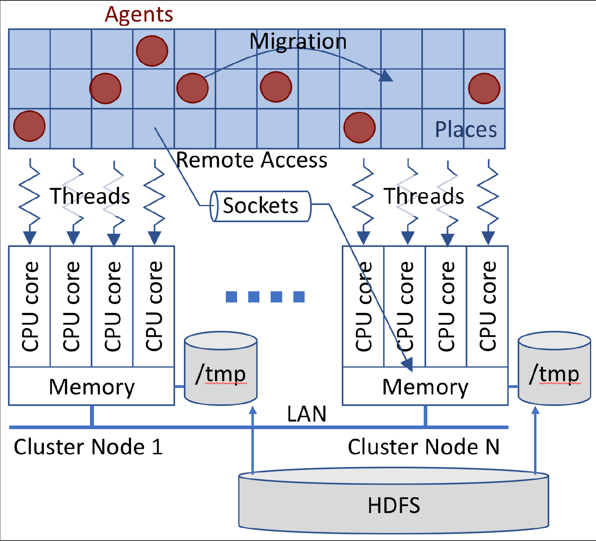
What is MASS?
MASS - MultiAgent Spatial Simulation
Library that enables simple parallel execution of user defined simulations.

Slide 4
Problem Definition
Update MASS C++ to bring it’s functionality more in line with current MASS JAVA.
Preparing MASS C++ for benchmarking, as well as perform benchmarks.
Update MASS C++ documentation and code organization.

Slide 5
What did I contribute?
Update MASS C++ library
Methods that were implemented in MASS JAVA
Built in neighbor functionality
Merged all branches to clean repository
Update MASS C++ documentation
Create MASS C++ Doxygen (Online documentation)
Update developers manual
Ensure MASS C++ is running on updated Linux systems.

Slide 6
Added functionality
doAll() - Creates a simpler interface for the application programmer, reducing the number of calls needed.
exchangeAll() - Allows the user to use the neighbor functionality.
onCreation(), onDeparture(), onArrival() interfaces for user defined functionality.

Slide 7
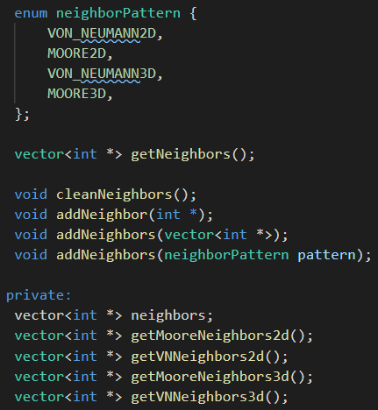
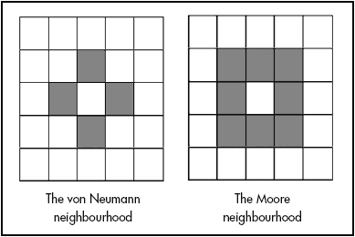
Neighbor functionality

Slide 8
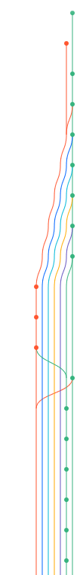
Repository clean up.
Manually merged 11 branches into develop branch, testing functionality added by previous students.
dev
Master
Time

Slide 9
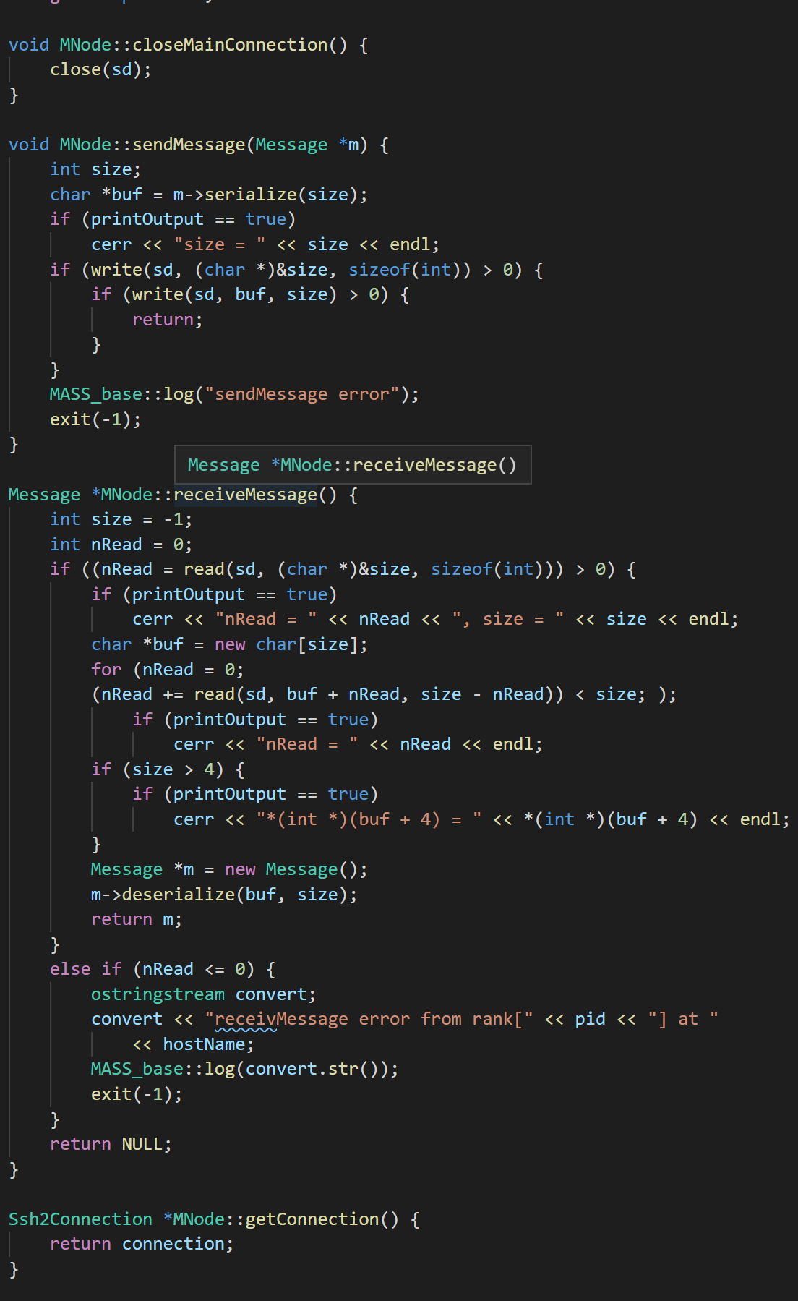
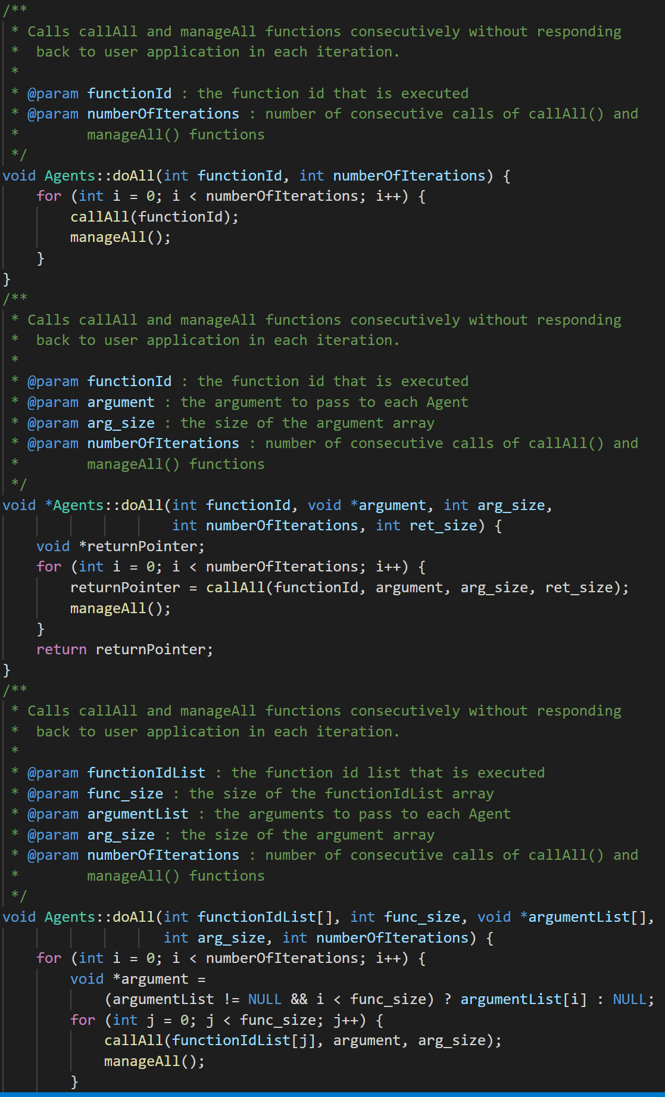
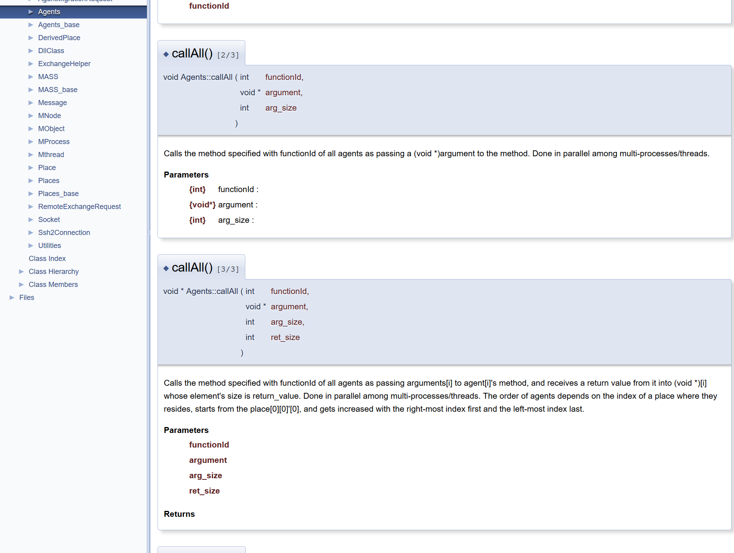
Creating Doxygen
I added full comments to MASS C++ to create a useful set of documentation.

Slide 10
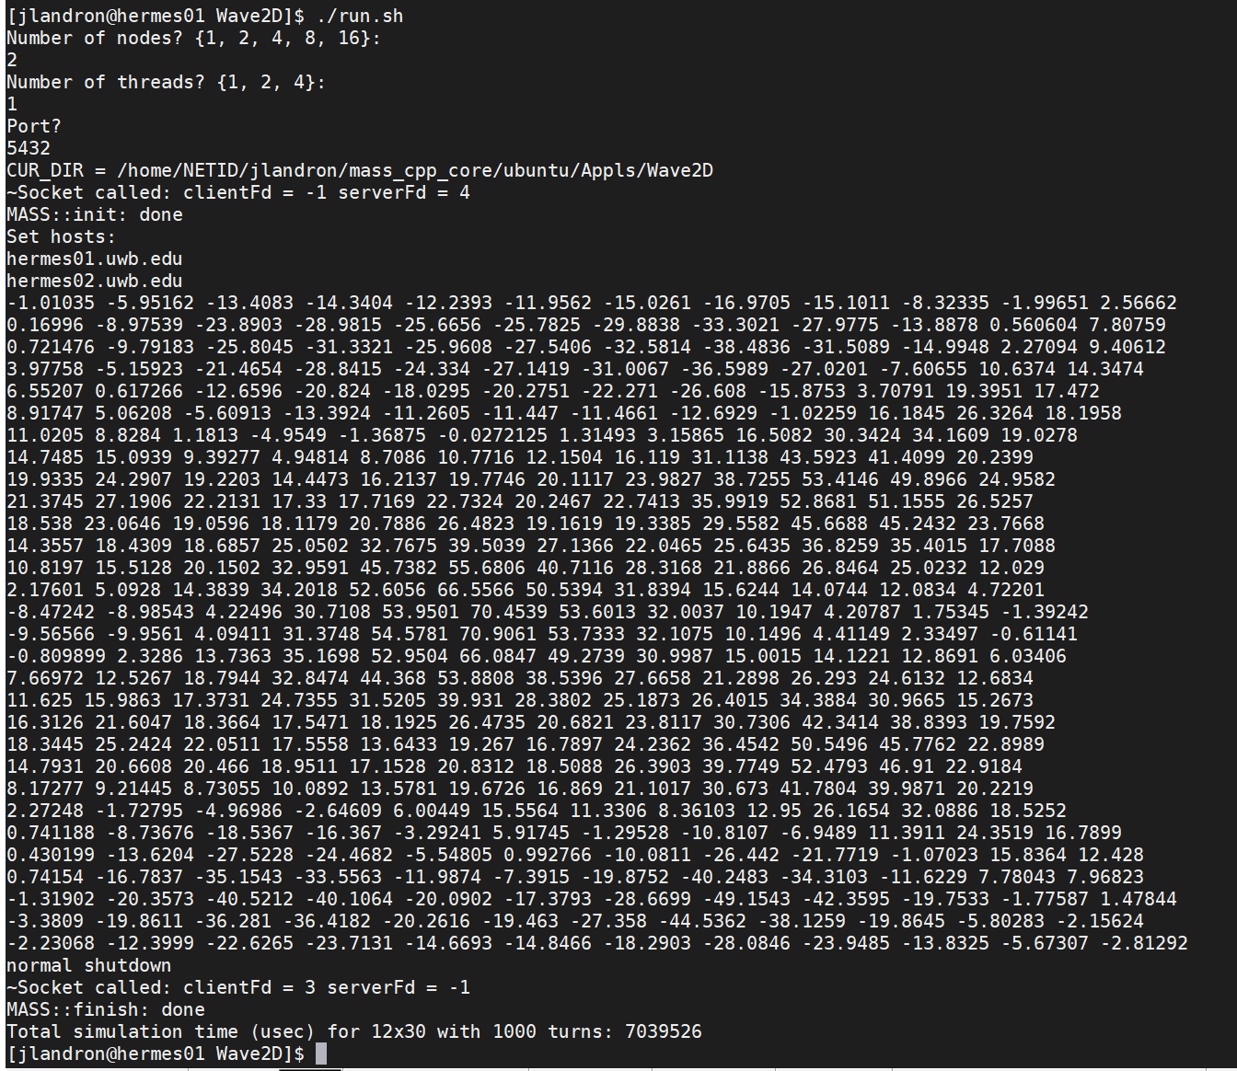
MASS C++ on hermes machines
One of the largest challenges I faced was the fact that the DSlab machines had a new OS, and MASS C++ had not been tested yet.
Library dependency errors
DNS errors
Socket errors
Network file system problems

Slide 11
Problems I ran into
Hermes Machines were updated to CentOS
Required library OpenSSL had been updated, requiring update of MASS SSH2 library.
MASS C++ is a extensive library, learning curve was steep.

Slide 12
What is the current status of MASS C++?
Updated with some functionality to match MASS Java
2 branches (master and dev) for future developers
Running on Hermes machines
Still having a issue with reliably establishing a connection
Ready to start benchmarking in distributed operation
Documentation is updated and published for future developers

Slide 13
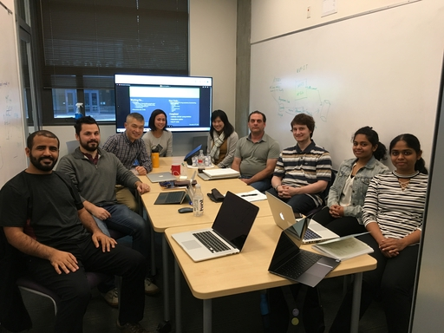
Special Thanks
Thank you to everyone who supported my learning and development, especially Dr.Munehiro Fukuda and the members of the DSlab.
https://depts.washington.edu/dslab/

Slide 14

Questions?

